Slide 1
Using Social Media Data as Early Warning Signals in Risk Management
Joanne, Helen and Luna

Slide 2
Overview
Motivation
Data and Source
Literature Reference
Methods
United Airlines
Amazon
Other Companies

Slide 3
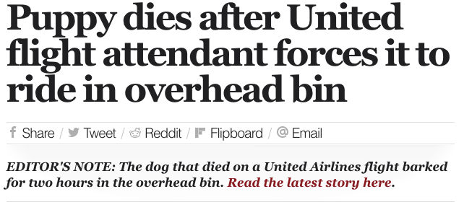
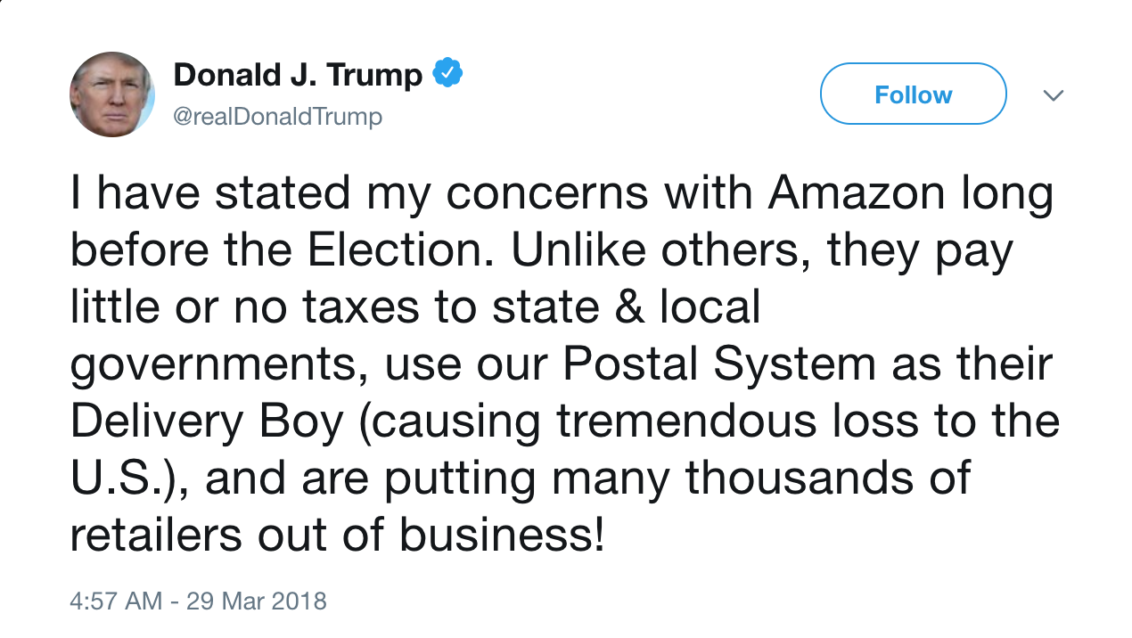
Recap & Motivation
Can social media data sentiment analysis be used to predict stock trends?
Do mentions of companies affect its stock value?
Notes:
Last time, we focused on United Airlines and how tweets about its incident affect the company’s stock. In the meantime, we also noticed that President Trump had started ranting about Amazon since March 29th.

Slide 4
Data
Twitter
United: 200,000+ tweets from March 7 to March 16
Amazon: 300,000+ tweets from March 24 to April 12
We use both intraday (high frequency) and daily stock
High frequency trade prices from Wharton Database Research Services
United: 1,444,514 trades from Jan 16 to March 16 (9:30 am -- 4:00 pm)
Amazon: 8,528,921 trades from Jan 1 to April 18 (9:30 am -- 4:00 pm)
Daily stock closing prices from yahoo finance via quantmod package
United: Jan 16 to March 16
Amazon: Jan 16 to April 25
Notes:
Daily stock closing prices from yahoo finance via quantmod package
Jan 1st ~ April 25th for Amazon (NASDAQ) Disney (NYSE)
Jan 1st ~ March 16th for United (NYSE)
Amazon high frequency trade via haas Jan 1st ~ April 18th

Slide 5
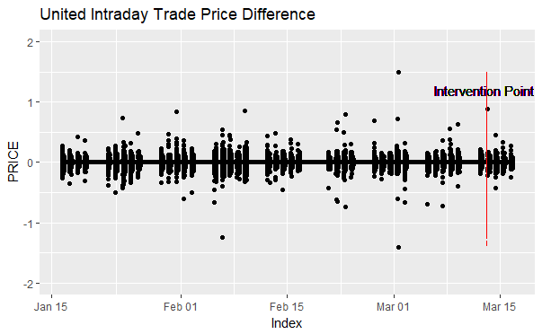
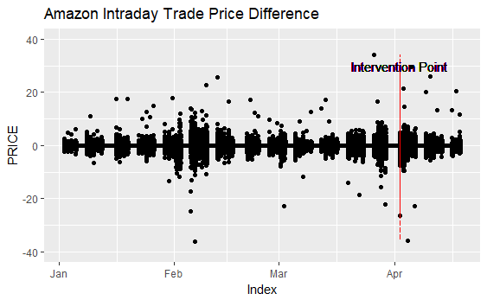
Red line: "2018-03-13 13:22:00"
Red line: "2018-04-02 09:30:00"
Notes:
Here are two sample EDA plots for United and Amazon Intraday Trade Price. Since the original dataset is not stationary, we used difference as return. The red line shows intervention points and we’ll discuss it later.

Slide 6
Literature Reference
Proellochs, Feuerriegel and Neumann (2015): Generating Domain-Specific Dictionaries Using Bayesian Learning, Proceedings of the 23rd European Conference on Information Systems (ECIS 2015), Muenster, Germany
The problem: existing dictionaries such as the Harvard-IV Psychological dictionary is not suitable in finance because positive and negative words could have different connotations based on the context in which it is used (i.e. psychological vs. financial document)
Domain-specific dictionaries created by Bayesian variable selection methods outperform existing dictionaries in terms of both their explanatory power and predictive performance, resulting in an improvement of up to 93.25% in the correlation between news sentiment and stock market returns
Miller C.(March 2017): An Introduction to Stock Market Data Analysis with R (Part 1)
Business 41202, Spring Quarter 2015, Mr. Ruey S. Tsay (Booth School of Business)
Notes:
Nicolas Pröllochs, Stefan Feuerriegel, Dirk Neumann, University of Freiburg

Slide 7
Literature Reference
STAT 510 9.2 Intervention Analysis (PennState)
Modified one of the possible patterns for intervention effect
Bollen J., Mao H., and Zeng X. (February 2011) Twitter mood predicts the stock market
Analyzed daily tweets to measure public moods (positive/negative mood and 6 dimensions)
The accuracy of DJIA predictions can be significantly improved by the inclusion of specific public mood dimensions
87.6% accuracy in predicting daily up/down changes in DJIA closing values
Nguyen T. H., Shirai K., and Velcin J. (July 2015) Sentiment analysis on social media for stock movement prediction
Integrate the sentiments in social media for the prediction of stock price movement
The current model only predicts if the stock price is up or down. (2.07% better than only using historical prices)
Notes:
6 dimensions (Calm, Alert, Sure, Vital, Kind, and Happy)

Slide 8
Sentiment Analysis
The SentimentAnalysis Package
Utilizes and returns scored sentiment based off of 4 dictionaries:
General Inquirer (GI): Harvard-IV
qdap (QDAP): collection of text analysis dictionaries and word lists, designed for transcript analysis
Henry’s Financial Dictionary (HE): ~200 words
Loughran-McDonald Financial Dictionary (LM): ~3000 words
Pros:
can create customized dictionaries through LASSO, ridge, OLS, or generalized linear models
More accurate than sentimentr package
Cons: computationally costly for large datasets
Notes:
Sentiment, variance comparison, garch volatility, intervention analysis

Slide 9
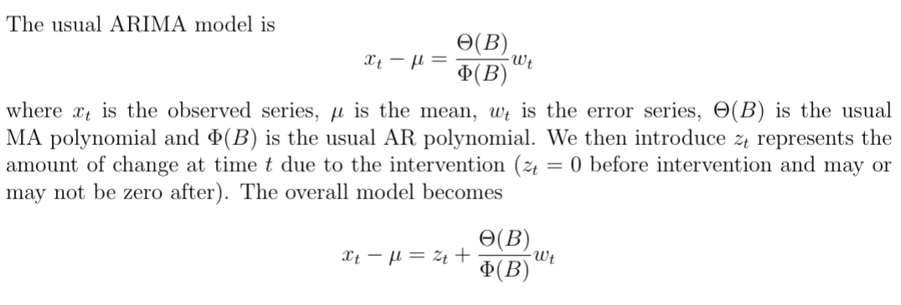
Intervention Analysis

Slide 10
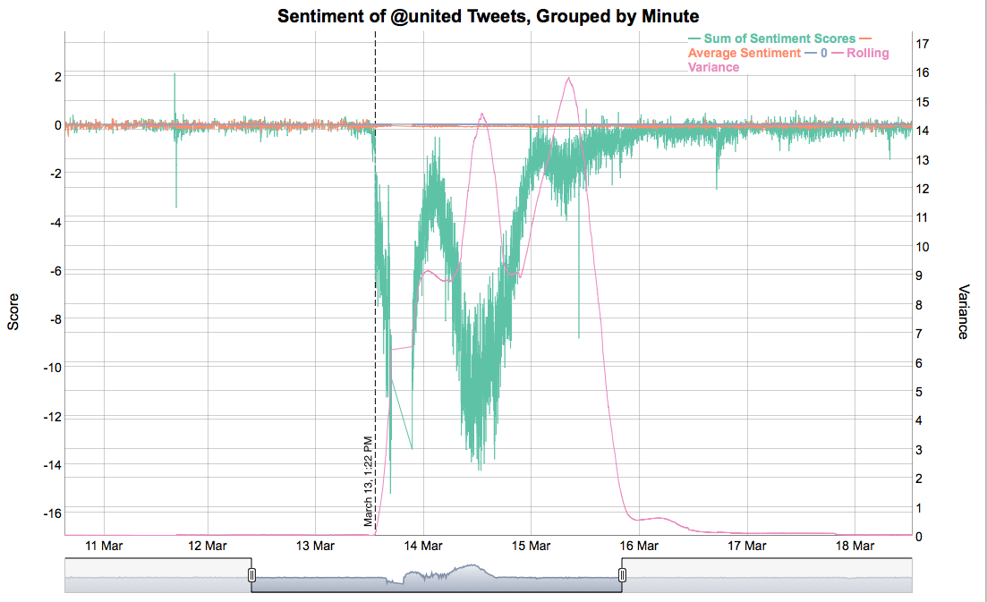
United Airlines
Point of Interest:
2018-03-13 13:22:00
Total Sentiment drops from -0.88 to -6
Rolling variance doubles

Slide 11

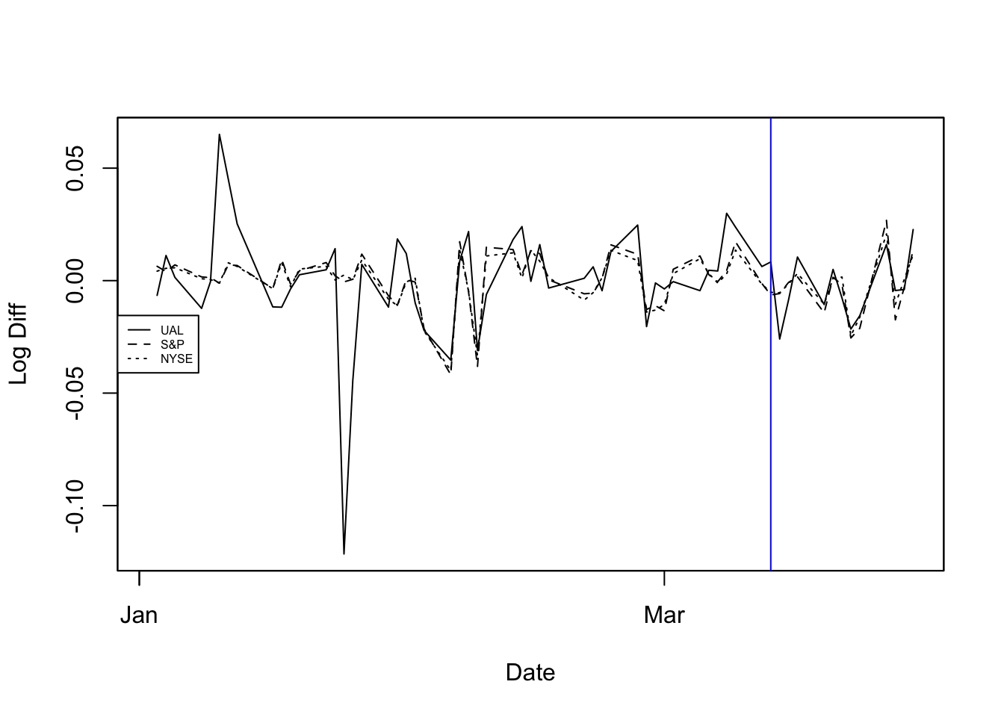
Compare United’s daily stock with NYSE and S&P 500 market index
Blue line: "2018-03-13"
United’s stock change is more extreme compared to market
Reasonable to measure the effect of sentiments on United’s stock
Notes:
The advantage of using log differences is that this difference can be interpreted as the percentage change in a stock but does not depend on the denominator of a fraction.

Slide 12
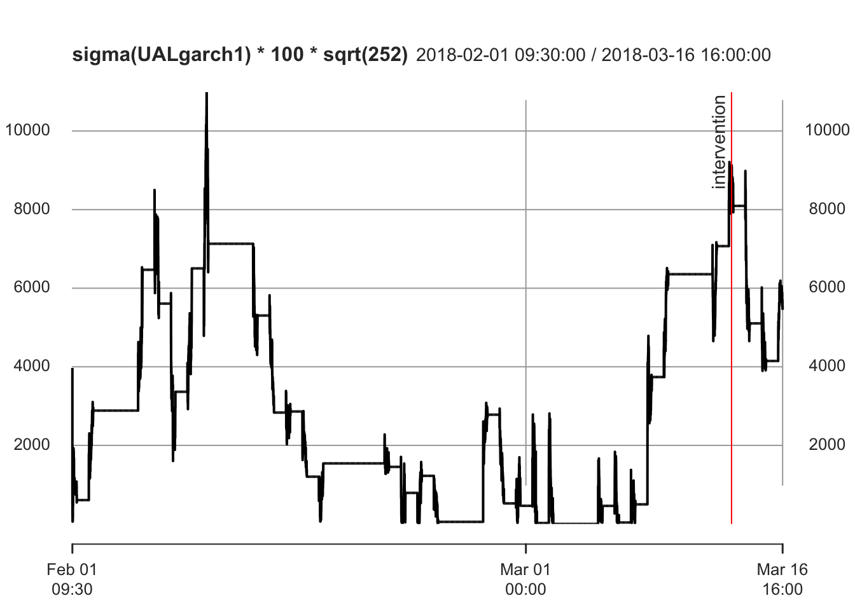
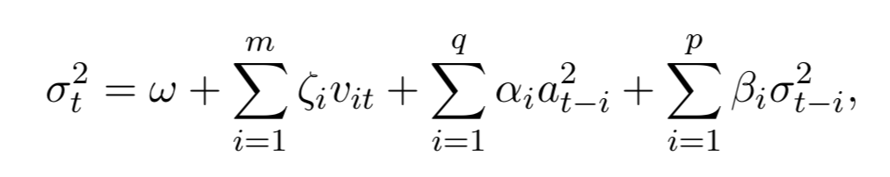
ugarchspec(variance.model = list(model = "sGARCH", garchOrder = c(1,1)), mean.model = list(armaOrder = c(0,0)), distribution.model = "std")
GARCH (Generalized AutoRegressive Conditional Heteroskedasticity) models volatility clustering
Red line: "2018-03-13 13:22:00"
sGARCH
Notes:
We know that returns do not have a normal distribution, that they have long tails. It is perfectly reasonable to hypothesize that the long tails are due entirely to garch effects, in which case using a normal distribution in the garch model would be the right thing to do. However, using the likelihood of a longer tailed distribution turns out to give a better fit (almost always). The t distribution seems to do quite well.
The sum of alpha1 and beta1 should be less than 1. Too large = explosive. The persistence of a garch model has to do with how fast large volatilities decay after a shock.
The variance.model is a list that gives the type of volatility model to fit, the order of the volatility model, and the existence of any exogenous variables.
The most commonly used mean specification is mean.model = list(armaOrder=c(0,0), include.mean=TRUE)
Volatility a seemingly universal attribute of market data

Slide 13
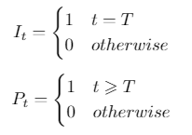


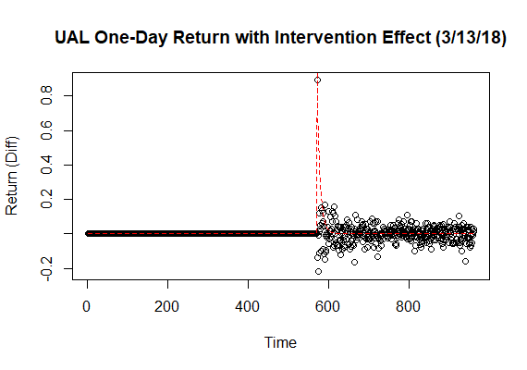
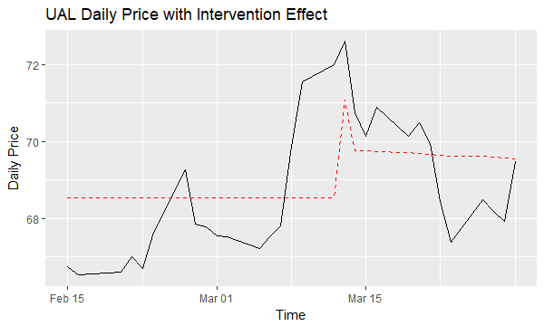
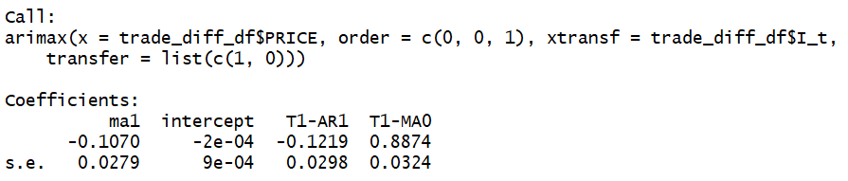
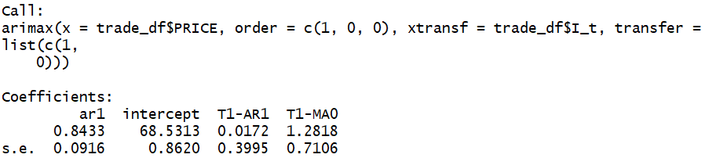
Intervention Effect Quantified
Notes:
To quantify intervention effect, we first tried to do it on intraday data. Because we used high frequency data and we believe that several hours after intervention will have the biggest effect, we focused on the day of intervention. From the plot, we saw our pattern looks similar as one known pattern from literature we mentioned, but it’s not the same, so we modified the formula.
We fitted model on UAL one day return data, and used the parameter we got from the model (intercept: u; AR: w1; MA: w0) to plug into the formula. After that, we also want to check if we can still observe and quantify intervention effect on daily data, so we did same thing on United daily stock price. From both plots, we can conclude that this intervention cause an immediate and short-term increase on stock value and stock value will gradually go back to mean value before.

Slide 14
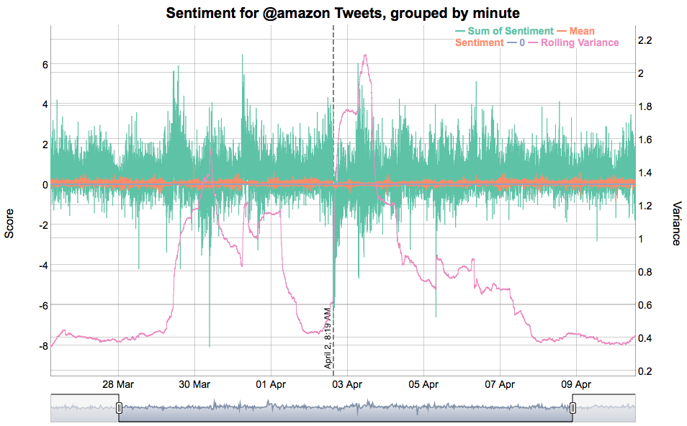
Amazon
Point of Interest:
2018-04-02 08:19:00
Total Sentiment drops from 0.41 to -6.94
Rolling variance triples
Notes:
Compared to the United case, Amazon case is more stick to our motivation since the event happened on Twitter.

Slide 15
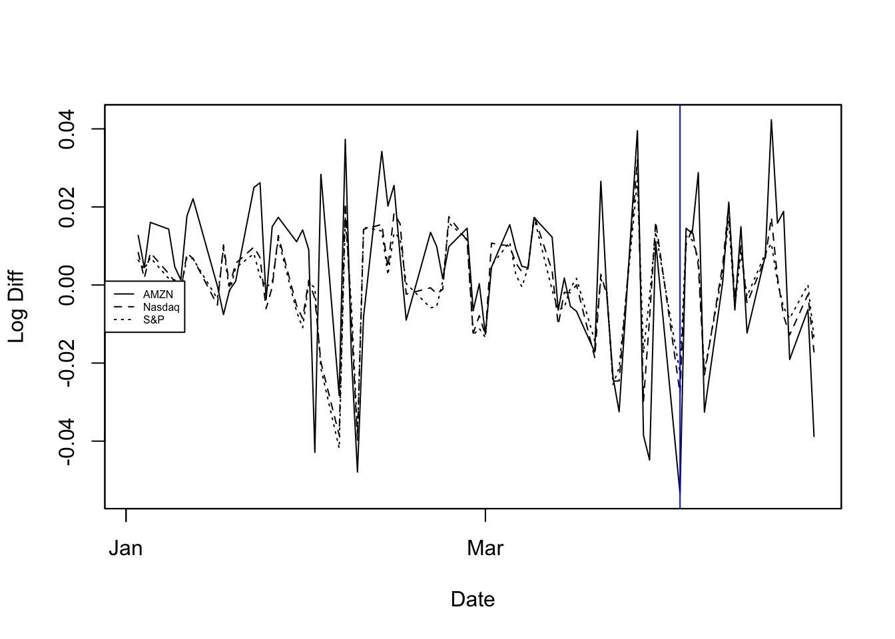
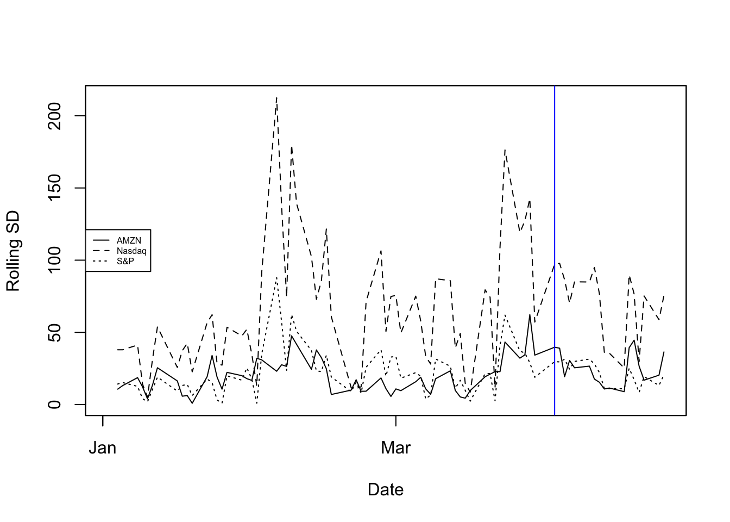
Compare Amazon’s daily stock with Nasdaq and S&P 500 market index
Blue line: "2018-04-02"
Amazon’s stock change is more extreme compared to market
Amazon’s rolling standard deviation is also inconsistent with those of the markets
rollapply(AMZNMarket, by.column = TRUE, FUN = sd, fill = NA, width = 3)
Notes:
The advantage of using log differences is that this difference can be interpreted as the percentage change in a stock but does not depend on the denominator of a fraction.

Slide 16
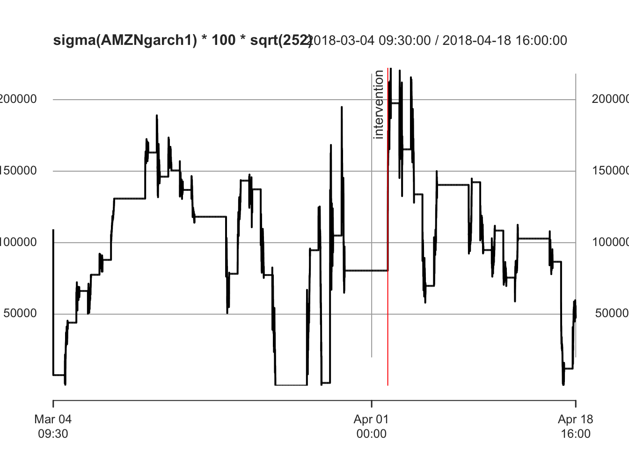
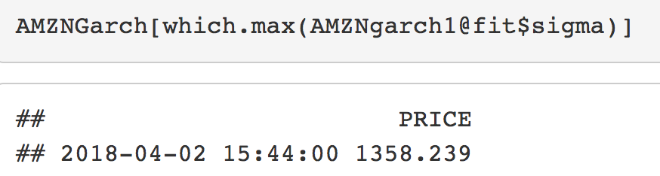
ugarchspec(variance.model = list(model = "sGARCH", garchOrder = c(1,1)), mean.model = list(armaOrder = c(0,0)), distribution.model = "std")
GARCH (Generalized AutoRegressive Conditional Heteroskedasticity) models volatility clustering
Red line: "2018-04-02 09:30:00"

Slide 17
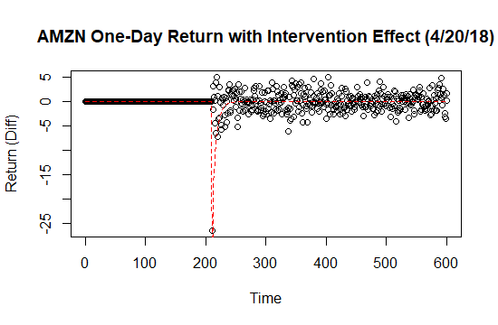
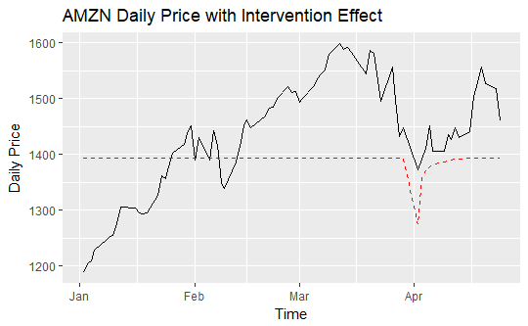
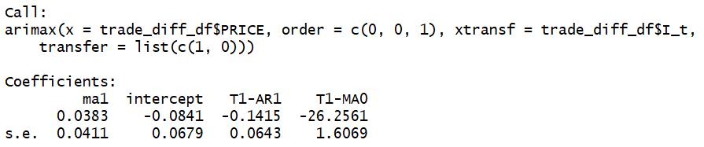
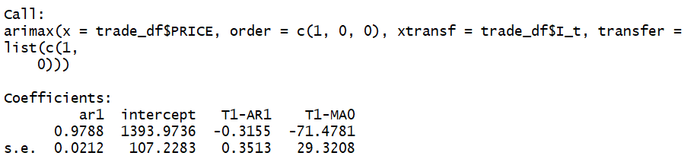
Intervention Effect Quantified
Notes:
For intervention effect quantify on Amazon, we observed the similar pattern as United, but there’s a slightly difference on value of w0, which is obtained from MA part. In Amazon case, we got a negative w0. That’s because this intervention caused a short-term decreasing on stock.
In this case, we can conclude that the intervention cause an immediate and short-term decrease on stock value and stock value will gradually go back to mean value before.

Slide 18
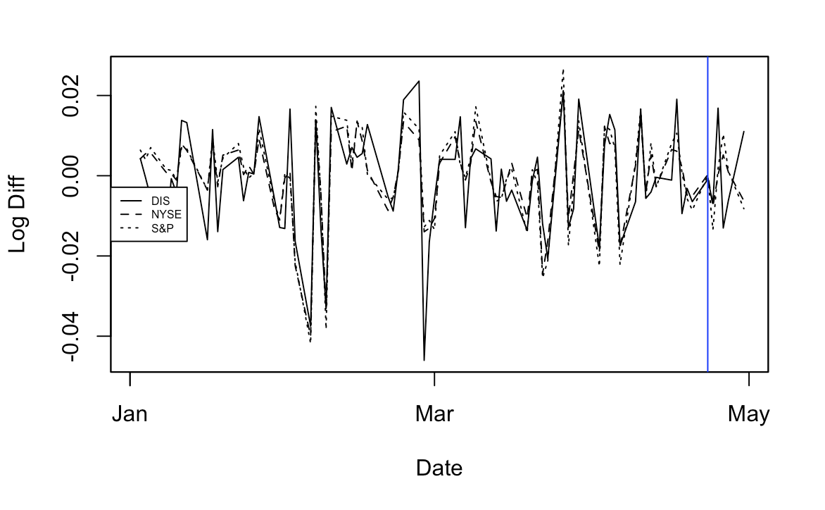
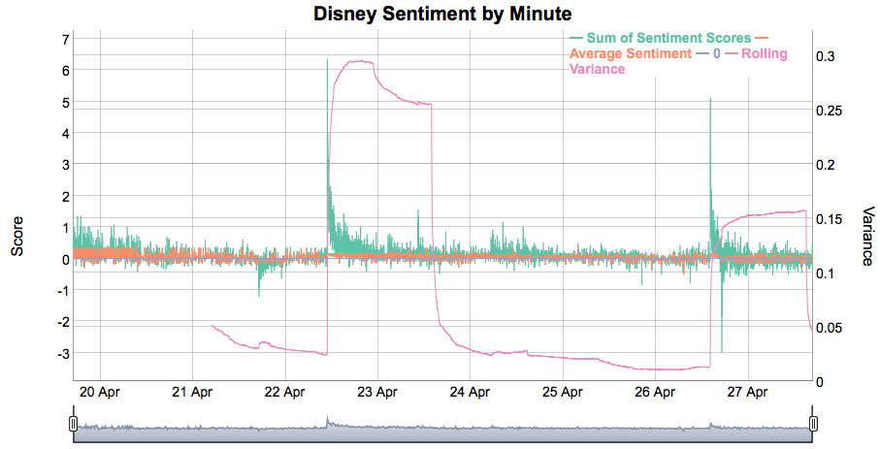
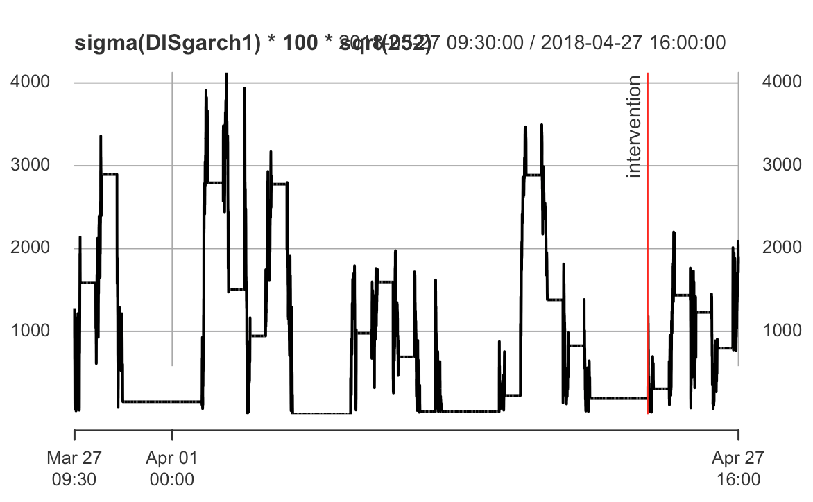
Disney
Intervention point from sentiment analysis: "2018-04-23 09:30:00"
Stock does not show corresponding movement
Low rolling volatility of sentiment

Slide 19
Conclusion
Next Steps
Mentions of a company and sentiments of a company does affect the company’s stock prices
Slight movement of Twitter sentiment may not affect the stock
More generalization
Extension of sentiment analysis to non-polarity sentiment (i.e. dimension)
More precise tweets selection

